Slide 1
Software Quality Assurance
/
Software Quality Engineering
Lecture 3
Naseer Ahmed

Slide 2
What Is Quality Engineering?
Quality engineering (QE) is a process that applies rigorous quality checks to each stage of product development. It does this through analysis, development, management, and maintenance of quality assurance (QA) protocols. QA is often continued after a product has been delivered.
The goal of QE is to ensure the quality of a product from the beginning, minimizing potential losses caused by defects. QE is different from traditional quality control measures in that it is present throughout the production process. In traditional systems, quality is only checked in the final production stages. In comparison, traditional methods are inefficient and can lead to additional expenses and work

Slide 3
What Is Software Quality Engineering?
Software quality engineering (SQE) is the application of QE practices to the software development lifecycle (SDLC). In software quality engineering, QE is closely integrated with existing agile and DevOps processes, as opposed to being added as a layer on top of existing workflows. This mirrors the shifted-left testing principles of DevSecOps teams and is intended to identify issues early on.
In software quality engineering, engineers play a key role. Quality engineers design, implement, and maintain policies and procedures used to ensure the quality of development processes. This requires a thorough understanding of evaluation practices and technologies in use, including artificial intelligence (AI), big data analytics, and automation.

Slide 4
What Is Software Quality Engineering?
The primary goals of software quality engineering are:
Process control and oversight
Implementing standards and metrics
Data collection and analysis
Test development
Identification of issues and solutions
Follow-up to ensure corrective actions

Slide 5
Practices of Software Quality Engineering
Practices of Software Quality Engineering
To ensure quality throughout the SDLC, you should follow several key standard practices of software quality engineering.
Functional testing
Engineers evaluate user interfaces (UI) and APIs to ensure that design specifications are met. During the functional testing process, core functions are tested along with inputs, menus, and installation procedures.

Slide 6
Practices of Software Quality Engineering
Peer review of code
Engineers should ensure that all source code is peer-reviewed. Peer review helps ensure that code is efficient and that logic is sound. It can also help developers learn from each other and improve collaboration. This is because a peer review of code requires clear communication of programming ideas and the reasoning behind implementation.
Static code analysis
Static code analysis evaluates source code according to predefined standards. Engineers implement automated tools to perform static code analysis. Frequently, these tools can be integrated into integrated development environments (IDEs). These tools can then highlight quality issues for developers in real-time, promoting the adoption of higher-quality practices.

Slide 7
Practices of Software Quality Engineering
Unit testing
Unit testing is the process of checking code units (components, methods, or classes) against inputs to determine validity. Ideally, engineers automate these tests to be performed any time changes are made to code.
User performance testing
User performance testing evaluates the speed of a product in a given environment. This testing can be done manually or automatically. It is designed to ensure that user experiences meet quality standards.

Slide 8
Quality Engineer vs Quality Analyst
Although both roles have the same end goal in mind, product quality, quality analysts and quality engineers don’t perform the same tasks.
Quality analysts are focused on ensuring quality through the planning and execution of quality standards. Their role begins at the project planning stage. Meanwhile, engineers are focused on standardizing and automating quality processes for greater efficiency and consistency. Their role begins after quality requirements are determined.

Slide 9
Quality Engineer vs Quality Analyst
Quality analysts are typically responsible for:
Sprint, test, and release planning.
Serving as a quality testing expert.
Managing backlogs to avoid oversight of acceptance criteria or edge cases
Executing functional tests.
Reporting on quality and testing status.
Maintaining quality documentation.
Identifying test cases.
Working with client teams to support acceptance testing, analyze issues, and classify issues as bugs or enhancements.
Manually configuring test environments.

Slide 10
Quality Engineer vs Quality Analyst
Quality engineers are typically responsible for:
Identifying repeated test cases.
Identifying tests requiring multiple environments, such as browsers or operating systems.
Identifying end-to-end test cases.
Automating tests to eliminate issues related to manual testing.
Integrating testing into continuous integration / continuous delivery (CI/CD) pipelines.
Identify and resolve bugs resulting from test automation failures.

Slide 11
Software Testing Life Cycle (STLC)
Software Testing Life Cycle (STLC) is a process used to test software and ensure that quality standards are met. Tests are carried out systematically over several phases. During product development, phases of the STLC may be performed multiple times until a product is deemed suitable for release.

Slide 12
Role of Software Testing Life Cycle
An STLC helps teams:
Refine the agile testing process, increasing consistency and effectiveness
Clearly define goals and expectations for each project aspect
Apply time constraints to project testing
Ensure that each feature is tested and passing before additional features are added
Verify that project requirements are met

Slide 13
Role of Software Testing Life Cycle
Some common activities included in a Software Testing Life Cycle framework are:
Analysis of client and stakeholder system requirements
Creation of a traceability matrix (a document that determines project completeness by comparing requirements with features)
Identification of testing techniques and types needed for each feature
Prioritization of features to be targeted
Analysis of how tasks can be automated
Identification of environment information

Slide 14
Role of Software Testing Life Cycle
Some advantage of STLC include:
Testing is shifted left in the development cycle. This ensures that tests are designed meaningfully and that feature specs are clear.
Systematic testing leads to a faster testing process and enables teams to uncover and address issues faster.
Project progress is easier to track since testing is performed with well-defined goals and phases.

Slide 15
STLC vs SDLC: How Do They Differ?
Although both are related to software development, with overlapping timelines, Software Development Life Cycle and Software Testing Life Cycle follow different goals and guidelines. STLC can be performed as a series of steps within the SDLC cycle or can be performed alongside SDLC phases.
The primary difference is that SDLC is responsible for collecting requirements and creating features accordingly. Meanwhile, STLC is responsible for creating tests adapted to the collected requirements and for verifying that features meet those requirements. If the SDLC created features that do more than necessary, it’s often okay, however, if STLC tests do more than necessary an unnecessary burden is placed on the team.

Slide 16
STLC vs SDLC: How Do They Differ?
Both life cycles require the cooperation of stakeholders, DevOps, and testing teams. Without this cooperation, you cannot verify that requirements are properly defined, that tests are relevant, or that results are applied properly.

Slide 17
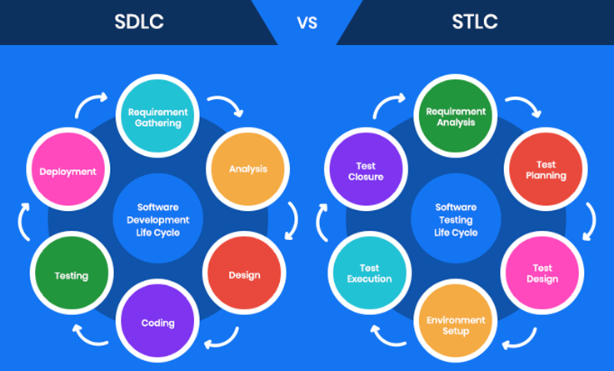
STLC vs SDLC: How Do They Differ?

Slide 18
The 6 STLC Phases In-Depth
Software Testing Life Cycle consists of 6 phases,
Each with defined entry and exit criteria and associated activities and deliverables.
Entry and exit criteria define when a phase can start and when it can end.
Activities and deliverables define what actions are performed and what the expected result is.
Some of these phases can be performed simultaneously while others require previous phases to be completed first.

Slide 19
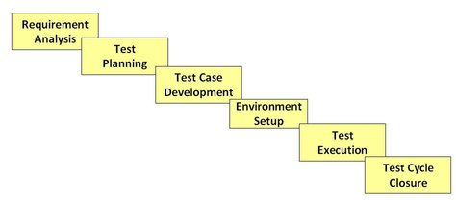
The 6 STLC Phases In-Depth

